Slide 1
Presentation brief for MCT’s
Title of presentation | Performing Real-Time Analytics with Stream Analytics.
Presentation\Lab length | Presentation: 40 - 45 minutes. Lab: 40 - 45 minutes.
Audience | Data Professionals, Data Architects, Business Intelligence Professionals, Developers.
Purpose | Understand data streams and event processing and the technologies that can ingest data streams. How to setup Stream Analytics to perform temporal analytics on streaming data.
(think) Student key takeaways | The student should understand the difference between data streams and event processing. The student should be clear of when event hubs are used to ingest data versus Internet of Things (IoT) Hubs. The student should know when Stream Analytics would be an appropriate technology to use for analysis.
(feel) Student desired mindset | The student should feel that Stream Analytics is a straightforward technology to use. The student should feel that Stream Analytics Query Language can make use of existing skills.
(do) Student outcomes | The student should be able to setup Event Hubs. The student should be able to setup a stream analytics job The students should be able to collect analysis on streaming data.
More information | For MCT course feedback, visit the Microsoft Official Courseware forum

Slide 2
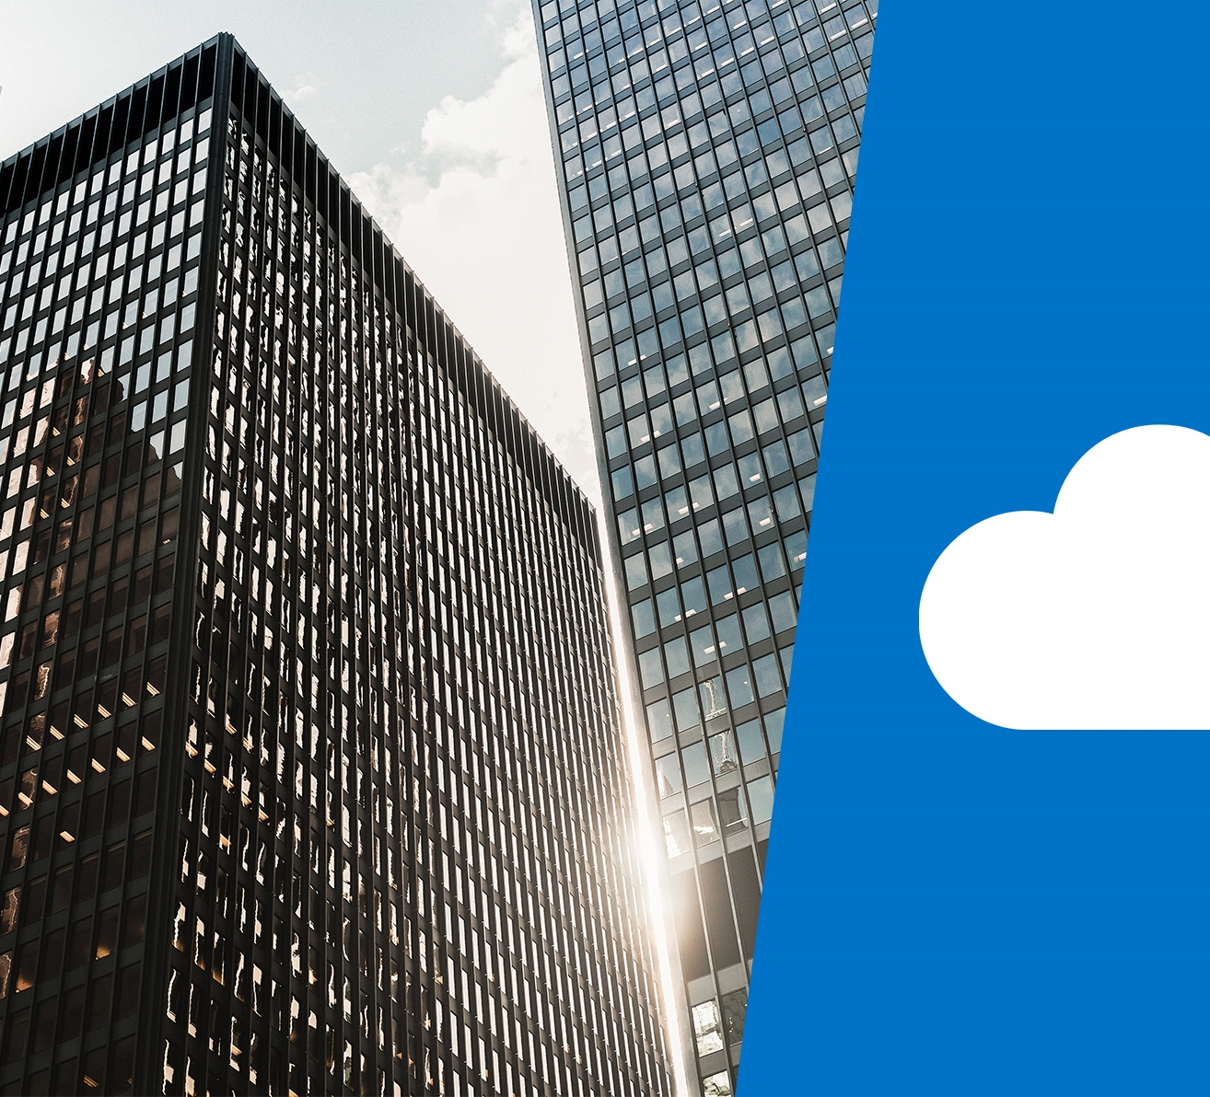
DP-200T01: Performing Real-Time Analytics with Stream Analytics

Slide 3
Agenda
L01 - Data streams and event processing
L02 - Data Ingestion with Event Hubs
L03 - Processing Data with Stream Analytics Jobs

Slide 4










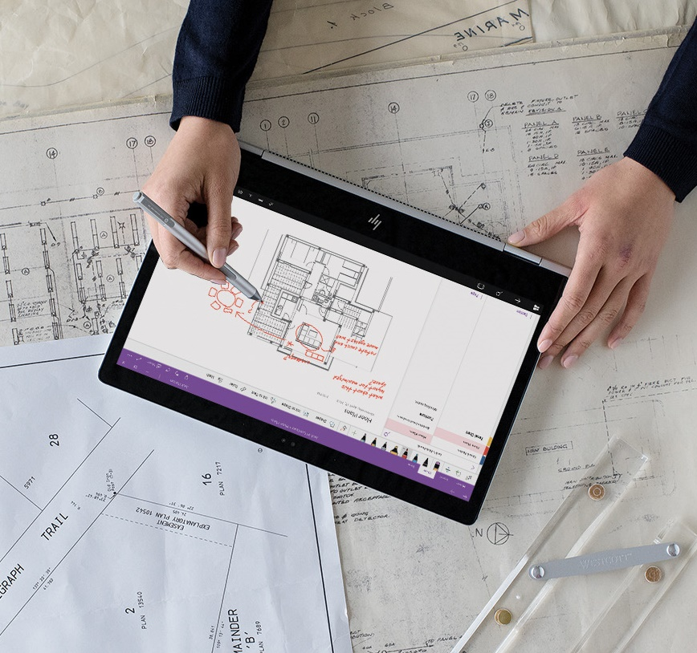


Lesson 01
Data Streams and
Event Processing
Data
Cloud
AI

Slide 5
Lesson Objectives
Explain data streams
Explain event processing
Learn about processing events with Azure Stream Analytics

Slide 6
What are data streams
Data Streams
In the context of analytics, data streams are event data generated by sensors or other sources that can be analyzed by another technology
Data Streams are used to:
Analyze Data
Continuously analyze data to detect issues and understand or respond to them.
Understand Systems
Understand component or system behavior under various conditions to fuel further enhancements of said system.
Trigger Actions
Trigger specific actions when certain thresholds are identified.
Data Stream Processing Approach
There are two approaches. Reference data is streaming data that can be collected over time and persisted in storage as static data. In contrast, streaming data have relatively low storage requirements. And run computations in sliding windows.

Slide 7
Event Processing
The process of consuming data streams, analyzing them, and deriving actionable insights out of them is called Event Processing and has three distinct components:
Event producer
Examples include sensors or processes that generate data continuously such as a heart rate monitor or a highway toll lane sensor.
Event processor
An engine to consume event data streams and deriving insights from them. Depending on the problem space, event processors either process one incoming event at a time (such as a heart rate monitor) or process multiple events at a time (such as a highway toll lane sensor).
Event consumer
An application which consumes the data and takes specific action based on the insights. Examples of event consumers include alert generation, dashboards, or even sending data to another event processing engine.

Slide 8
Processing events with Azure Stream Analytics
Microsoft Azure Stream Analytics is an event processing engine. It enables the consumption and analysis of high volumes of streaming data in real time.
Source
Ingestion
Analytical Engine
Destination
Sensors
Systems
Applications
Event Hubs
IoT Hubs
Azure Blob Store
Stream Analytics Query Language
.NET SDK
Azure Data Lake
Cosmos DB
SQL Database
Blob Store
Power BI

Slide 9
Review Questions
Q01 – Which of the following technologies typically provide an ingestion point for data streaming in an event processing solution that uses static data as a source?
A01 – Azure Blob storage

Slide 10
Lesson 02
Data Ingestion
with Event Hubs
Data
Cloud
AI

Slide 11
Lesson Objectives
Describe Azure Event Hubs
Create an Event Hub
Evaluate the performance of an Event Hub
Configure applications to use an Event Hub

Slide 12
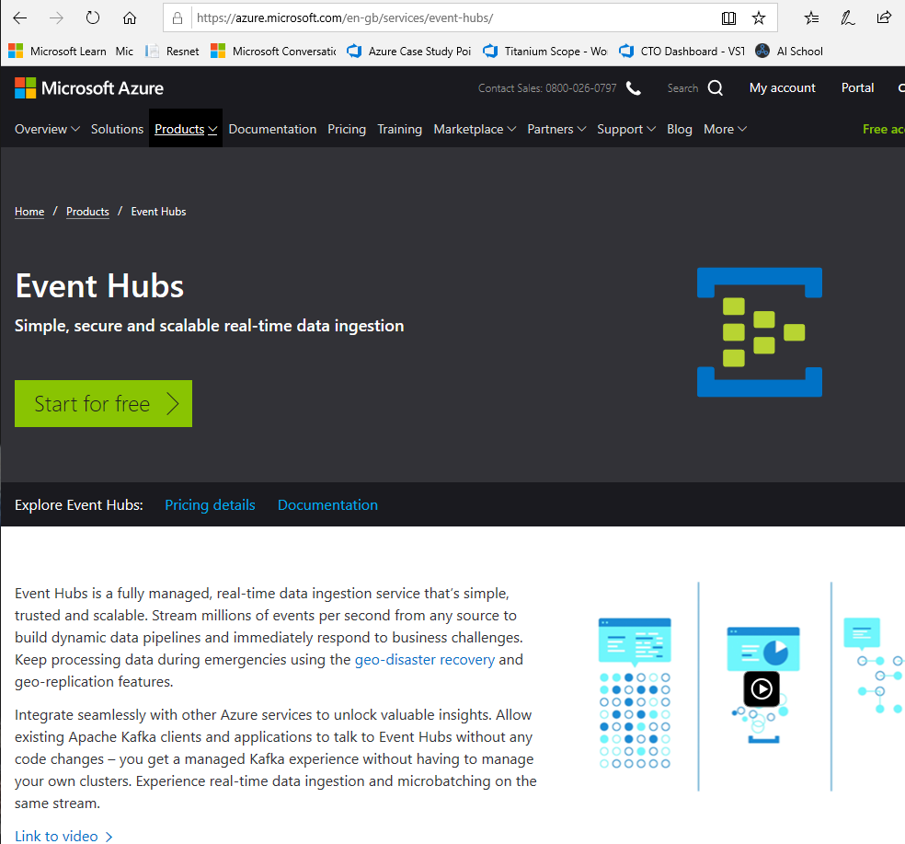
Azure Event Hubs
“Azure Event Hubs is a highly scalable publish-subscribe service that can ingest millions of events per second and stream them into multiple applications.”

Slide 13
Create an event hub namespace:
In the Azure portal, select NEW, type Event Hubs, and then select Event Hubs from the resulting search. Then select Create.
Provide a name for the event hub, and then create a resource group. Specify xx-name-eh and xx-name-rg respectively, XX- represent your initials to ensure uniqueness of the Event Hub name and Resource Group name,
Click the checkbox to Pin to the dashboard, then select the Create button.
Create an event hub
After the deployment is complete, click the xx-name-eh event hub on the dashboard.
Then, under Entities, select Event Hubs.
To create the event hub, select the + Event Hub button. Provide the name socialstudy-eh, and then select Create.
To grant access to the event hub, we need to create a shared access policy. Select the socialstudy-eh event hub when it appears, and then, under Settings, select Shared access policies.
Under Shared access policies, create a policy with MANAGE permissions by selecting + Add. Give the policy the name of xx-name-eh-sap , check MANAGE, and then select Create.
Select your new policy after it has been created, and then select the copy button for the CONNECTION STRING - PRIMARY KEY entity.
Paste the CONNECTION STRING - PRIMARY KEY entity into Notepad, this is needed later in the exercise.
Leave all windows open
Create an Event Hub

Slide 14


Configure Applications to use Event Hubs
<name>ns Service Bus Namespace
<name>eh
Event Hub
Queues streaming data
Send
Receive
Mobile
Application
API

Slide 15
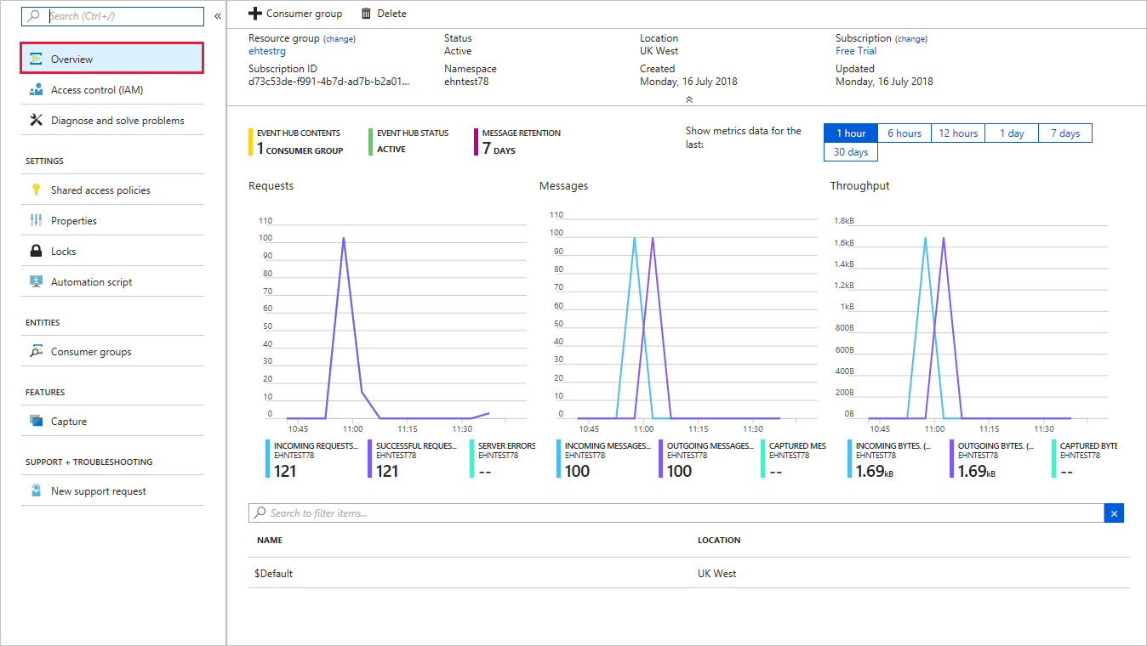
Evaluating the Performance of Event Hubs

Slide 16
Review Questions
Q01 - Applications that publish messages to Azure Event Hub very frequently will get the best performance using Advanced Message Queuing Protocol (AMQP) because it establishes a persistent socket. True or False?
A01 – True
Q02 - By default, how many partitions will a new Event Hub have?
A02 – 2
Q02 - If an Event Hub goes offline before a consumer group can process the events it holds, those events will be lost. True or False?
A02 – False

Slide 17
Lesson 03
Processing Data with
Stream Analytics Jobs
Data
Cloud
AI

Slide 18
Lesson Objectives
Explore the Streaming Analytics workflow
Create a Stream Analytics Job
Configure a Stream Analytics job input
Configure a Stream Analytics job output
Write a transformation query
Start a Stream Analytics job

Slide 19








Azure Stream Analytics Workflow
Complex Event Processing of Stream Data in Azure
Input Adapter
Complex Event Processor
Output Adapter
Notes:
Azure Stream Analytics provides event processing of stream data as a service. Somewhat narrower in scope than Storm on HDInsight, Azure Stream Analytics provides a simple and very cost-effective way to process events. For instance, analyze streams of data for time-sequence relationships, all with a SQL-like query. Output data to Power BI to provide near-real-time reporting.

Slide 20
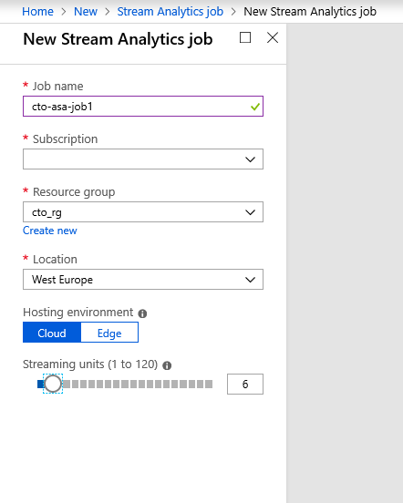
Create Stream Analytics Service
Job name
Subscription
Resource group
Location
Notes:
To create an ASA service requires four parameters:
Job name
Subscription
Resource group
Location

Slide 21
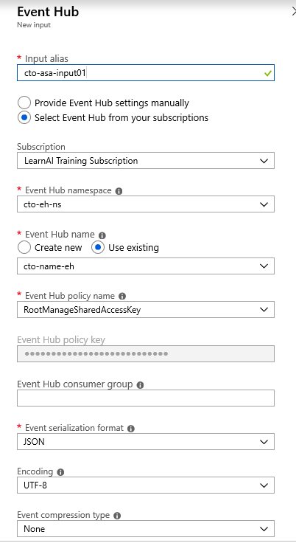
Create a Stream
Analytics Job Input.

Slide 22
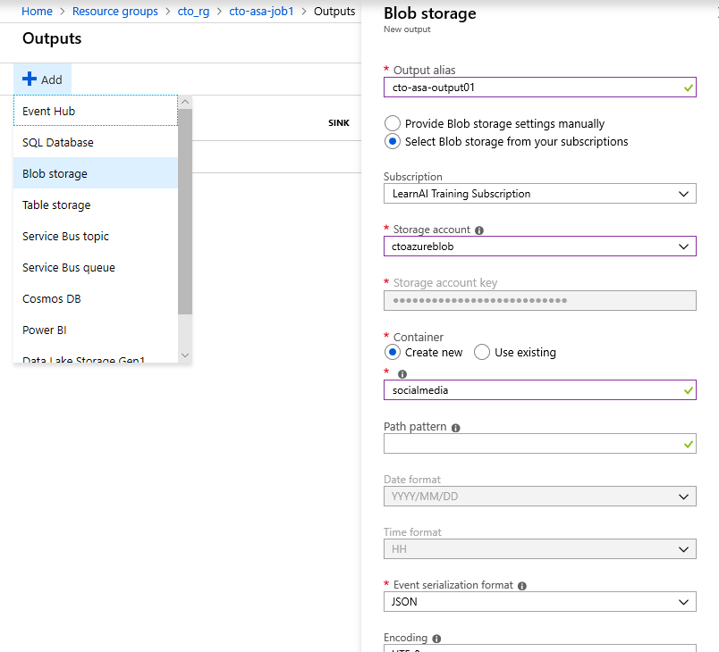
Create a Stream
Analytics Job Output.

Slide 23
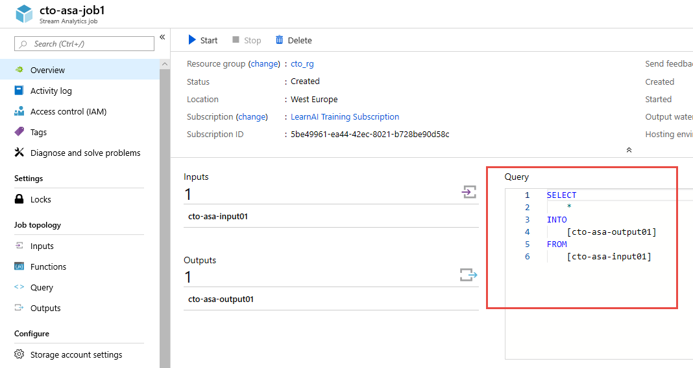
Write a transformation query
Notes:
To create an ASA service requires four parameters:
Job name
Subscription
Resource group
Location

Slide 24
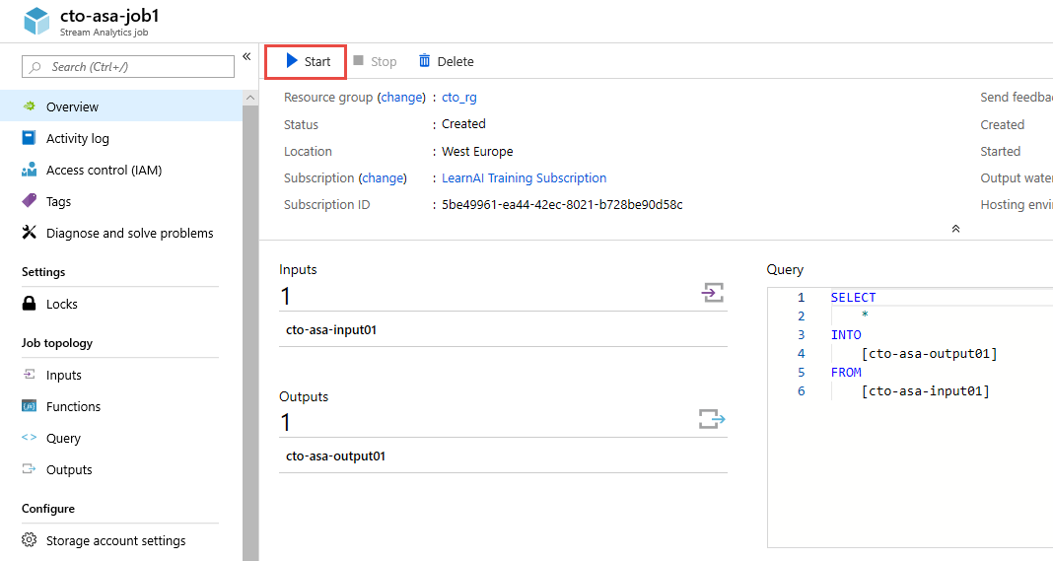
Start a Stream Analytics Job

Slide 25
Review Questions
Q01 – Which job input consumes data streams from applications at low latencies and high throughput?
A01 – Event Hubs
Q02 – Streaming Analytics Query Language is a subset of which query language
A02 – T-SQL
Q03 – You are a Data Engineer for Contoso. You want to view key health metrics of your Stream Analytics jobs. Which tool in Streaming Analytics should you use?
A03 – Dashboards

Slide 26

Lab: Performing Real-Time Analytics with Stream Analytics

Slide 27
Lab overview
The students will be able to describe what data streams are and how event processing works and choose an appropriate data stream ingestion technology for the AdventureWorks case study. They will provision the chosen ingestion technology and integrate this with Stream Analytics to create a solution that works with streaming data.
Lab objectives
After completing this lab, you will be able to:
Explain data streams and event processing
Data Ingestion with Event Hubs
Processing Data with Stream Analytics Jobs

Slide 28
Lab scenario
As part of the digital transformation project, you have been tasked by the CIO to help the marketing departments become more productive with aspects of their work. Over the last few years the marketing department has been using Twitter to amplify marketing message around the bicycle products that are sold.
Whilst the department can provide reach numbers post campaign, they are unable to understand who is interacting with their campaigns in real-time, as the volumes are difficult to track manually. As a result, they would like to implement a system that can track in real-time who is responding to their campaign.
At the end of this lad, you will have:
Explain data streams and event processing
Data Ingestion with Event Hubs
Processing Data with Stream Analytics Jobs

Slide 29
Lab review
Exercise 1 – In event processing, what would social media sites be classed?
Exercise 2 – What methods are available for ingesting data? How are they different?
Exercise 3 – What function can be used to perform temporal analysis in Stream Analytics Query Language?

Slide 30

Next steps
Module Summary
In this module, you have learned about:
- Data streams and event processing.
- Data Ingestion with Event Hubs.
- Processing Data with Stream Analytics Jobs.
After the course, consider reading the Reference architecture for real-time event processing with Microsoft Azure Stream Analytics

